Slide 1
CS210: Computer Science II

Slide 2
Unit 1 Module 1: Pointers
Some fundamentals
Pointers

Slide 3
These reinforce (not compete with) the “fundamentals.”
Write for clarity and correctness first.
Avoid premature optimization. By default, prefer clear over optimal.
Avoid premature pessimization.” Prefer faster when equally clear.

Slide 4
The confusion of the language is upon us
int x(0); // initializer is in parentheses
int y = 0; // initializer follows "="
int z{ 0 }; // initializer is in braces
Even int z = { 0 } works !
To address the confusion of multiple initialization syntaxes, as well as the fact that they don’t cover all initialization scenarios, C++11 introduces uniform initialization: a single initialization syntax that can, at least in concept, be used anywhere and express everything.

Slide 5
The wonders of auto
“What should every C++ programmer be expected to know?”
Why this
for( auto i = begin(c); i!= end(c); ++i) { … use(*i); … }
when you can do this
for( auto &e : c ) { … use(e); … }
and soon this (c++14)
for( e : c ) { … use(e); … }

Slide 6
typedef deprecated?
• since c++11, we can use type alias in place of typedef. It is a name that refers to a previously defined type.
Prior: typedef double* doublePtr;
doublePtr dPtr;
C++11: using doublePtr = double*;
the name 'doublePtr' is now an alias for pointer to double

Slide 7

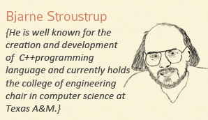
Do not fear the pointer – fear the Roo!

Slide 8
REVIEW
Pointers are a data type and they hold addresses of other values in memory. Format is the type then the * and then the name of the pointer variable. The address of operator, &, is used to get the address of a variable and store it in our pointer. int *ptr = &dataVar The * dereference operator is used to get the value of the address that is in the pointer. a.k.a. the value of. someVar = *Ptr An array of pointers int *twoHundred[200]

Slide 9
REVIEW
*ptrVar is an alias for varNum varNum = varNum +75; Here we just store the value +75 into the current value varNum = *ptrVar + 75; This takes the (dereference) value at the address of the pointer variable and uses it in the computation *ptrVar = *ptrVar + 75; This takes the deref of pointer (the value) and adds 75. Then stores the value (because it's dereferenced on the left) in the location in memory. &*ptrVar
give me the address of varNum, because the pointer variable is an alias.

Slide 10
As a Function parameter
Pointers are full-fledged types
Can be used just like other types
Can be function parameters
Can be returned from functions
Example:
This function declaration:
Has "pointer to an int" parameter
Returns "pointer to an int" variable
int* findOtherPointer(int *p);

Slide 11
Delete, Null, and Dangling Pointers
delete p;
Destroys dynamic memory
But p still points there
Called "dangling pointer"
If p is then dereferenced ( *p )
Unpredicatable results
Often disastrous
Avoid dangling pointers
Assign pointer to NULL after delete: delete p; p = NULL;

Slide 12
Pointers and Dynamic Arrays
Array variables
Really pointer variables
Standard array
Fixed size
Dynamic array
Size not specified at programming time
Determined while program running
Using doublePtr double* ;
doublePtr d;
d = new double[10];

Slide 13
The new Operator
Since pointers can refer to variables…
No "real" need to have a standard identifier
Can dynamically allocate variables
Operator new creates variables
No identifiers to refer to them
Just a pointer
p1 = new int;
Creates new "nameless" variable, and assigns p1 to "point to" it
Can access with *p1
Use just like ordinary variable
cin >> *p1;
*p1 = *p1 + 7;
cout << *p1;

Slide 14
An array of pointers
ptrArr *arrayOfPtrs[100]; // an array of 100 ptrArr pointers
int **myDynamicArray = new int*[SIZE];
// a pointer to a dynamic array of pointers
int **vacancyList = new int*[vacantRooms];
// a pointer with the list of vacancies that are addresses held in a dynamic array
14
Pointers

Slide 15
An array of pointers
// array of vacant positions
// allocates an array the size of the number of vacancies
// load the dynamic array with the transfers
char **pointerVacancies = new char*[vacantCount];
if (vacantCount > 0)
{
openRooms = true;
vacantCount = 0;
for (int i = 0; i < FLOOR_ARRAY_SIZE; ++i){
for (int j = 0; j < ROOM_ARRAY_SIZE; ++j){
if(hospitalFloors[i][j] == VACANT)
{
pointerVacancies[vacantCount] =
&hospitalFloors[i][j];
vacantCount +=1;
}
}
}
}
15
Pointers

Slide 16
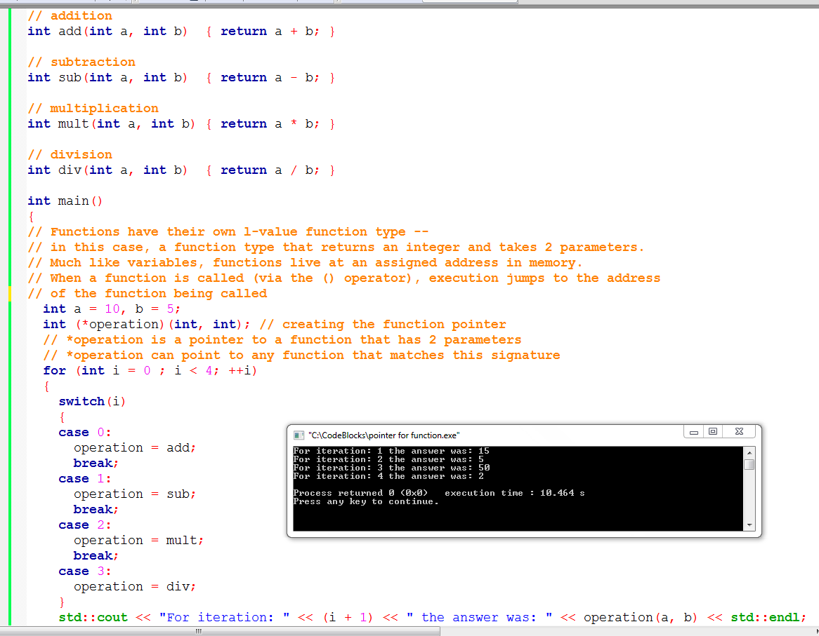
SAMPLE PROGRAM: Another Example – pointer to function
SAMPLE PROGRAM: pointer to function

Slide 17
Using Smart Pointers to Avoid Memory Leaks
In C++11, you can use smart pointers to dynamically allocate memory and not worry about deleting the memory when you are finished using it.
Three types of smart pointer:
unique_ptr
shared_ptr
weak_ptr
Must #include the memory header file:
#include <memory>
Focus on using the unique_ptr:
unique_ptr<int> ptr( new int );

Slide 18
Using Smart Pointers to Avoid Memory Leaks (cont.)
Name of the pointer ⬇
unique_ptr<int> ptr ( | new int |  |  | );
⬆
Data type that the pointer will point to. | Expression that dynamically allocates the memory.
The notation <int> indicates that the pointer can point to an int .
The name of the pointer is ptr .
The expression new int allocates a chunk of memory to hold an int.
The address of the chunk of memory will be assigned to ptr.

Slide 19

Sample Program: Using Smart Pointers
// This program demonstrates a unique_ptr. #include <iostream> #include <memory> using namespace std; int main() { // Define a unique_ptr smart pointer, pointing // to a dynamically allocated int. unique_ptr<int> ptr( new int ); // Assign 99 to the dynamically allocated int. *ptr = 99; // Display the value of the dynamically allocated int. cout << *ptr << endl; return 0; }
99
unique_ptr<int[]> ptr ( new int[varOfSize]);

Slide 20
Sample Program: Using Smart Pointers
3 #include <iostream>
4 #include <memory>
5 using namespace std;
6
7 int main()
8 {
9 int max; // Max size of the array
10
11 // Get the number of values to store.
12 cout << "How many numbers do you want to enter? ";
13 cin >> max;
14
15 // Define a unique_ptr smart pointer, pointing
16 // to a dynamically allocated array of ints.
17 unique_ptr<int[]> ptr( new int[max]);
18
19 // Get values for the array.
20 for (int index = 0; index < max; ++index)
21 {
22 cout << "Enter an integer number: ";
23 cin >> ptr[index];
24 }
25
26 // Display the values in the array.
27 cout << "Here are the values you entered:\n";
28 for (int index = 0; index < max; ++index)
29 cout << ptr[index] << endl;
30
31 return 0;
32 }

Slide 21
Sample Program: Using Smart Pointers
unique_ptr<int[]> shift(int arr[], int size)
{
// Make sure the new array size is greater than zero.
if (size > 0)
{
// Allocate an array one element larger
// than the array that was passed as
// an argument.
unique_ptr<int[]> copy( new int[size + 1] );
// Set the first element of the new
// array to 0.
copy[0] = 0;
// Copy arr's elements to the new array,
// shifted one position toward the end
// of the array.
for (int index = 0; index < size; ++index)
{
copy[index + 1] = arr[index];
}
}
// Return a pointer to the new array.
return copy;
}

Slide 22
When? Using Smart Pointers
Smart pointers can be useful in the situation where the logic structure of a program dictates that an object must be dynamically created by one function and later deleted by another function and these two functions are unrelated to each other (not member of the same class).
If the same function or class is responsible for creating and deleting the object then you don't need a smart pointer.

Slide 23
When? Passing Smart Pointers
Never pass smart pointers (by value or by reference) unless you actually want to manipulate the pointer
⇒ that is store, change, or let go of a reference.

Slide 24
When? Using unique ptr
Express ownership using unique_ptr wherever possible, including when you don’t know whether the object will actually ever be shared.
 It’s free = exactly the cost of a raw pointer, by design.
 It’s safe = better than a raw pointer, including exception-safe.
 It’s declarative = expresses intended uniqueness and source/sink semantics.
 It removes many (often most) objects out of the ref counted population.

Slide 25
NEW continued …with Class types
Creates new dynamic variable
Returns pointer to the new variable
If type is class type:
Constructor is called for new object
Can invoke different constructor with initializer arguments: MyClass *mcPtr; mcPtr = new MyClass(32.0, 17);
Can still initialize non-class types:
int *n;
n = new int(17); //Initializes *n to 17
MyType *p;
p = new MyType;
SomeClass *classPtr;
classPtr = new SomeClass;

Slide 26
These next few tidbits are good to relate to the project. How are you feeling about pointers?

Slide 27
Multidimensional Dynamic Arrays
To create a 3x4 multidimensional dynamic array
View multidimensional arrays as arrays of arrays
First create a one-dimensional dynamic array
Start with a new definition: using intArrayPtr = int*;
Now create a dynamic array of pointers named m: intArrayPtr *mem = new intArrayPtr[3];
For each pointer in mem, create a dynamic array of int's
for (int i = 0; i < 3; ++i) mem[i] = new int[4];

Slide 28
A Multidimensial Dynamic Array
The dynamic array created on the previous slide could be visualized like this:
mem
intArrayPtr's
intArrayPtr *
int's

Slide 29
Deleting Multidimensional Arrays
To delete a multidimensional dynamic array
Each call to new that created an array must have a corresponding call to delete[ ]
Example: To delete the dynamic array created on a previous slide: for ( i = 0; i < 3; ++i)
{ delete [ ] mem[i]; //delete the arrays of 4 ints }
delete [ ] mem; // delete the array of pointers (intArrayPtrs)

Slide 30
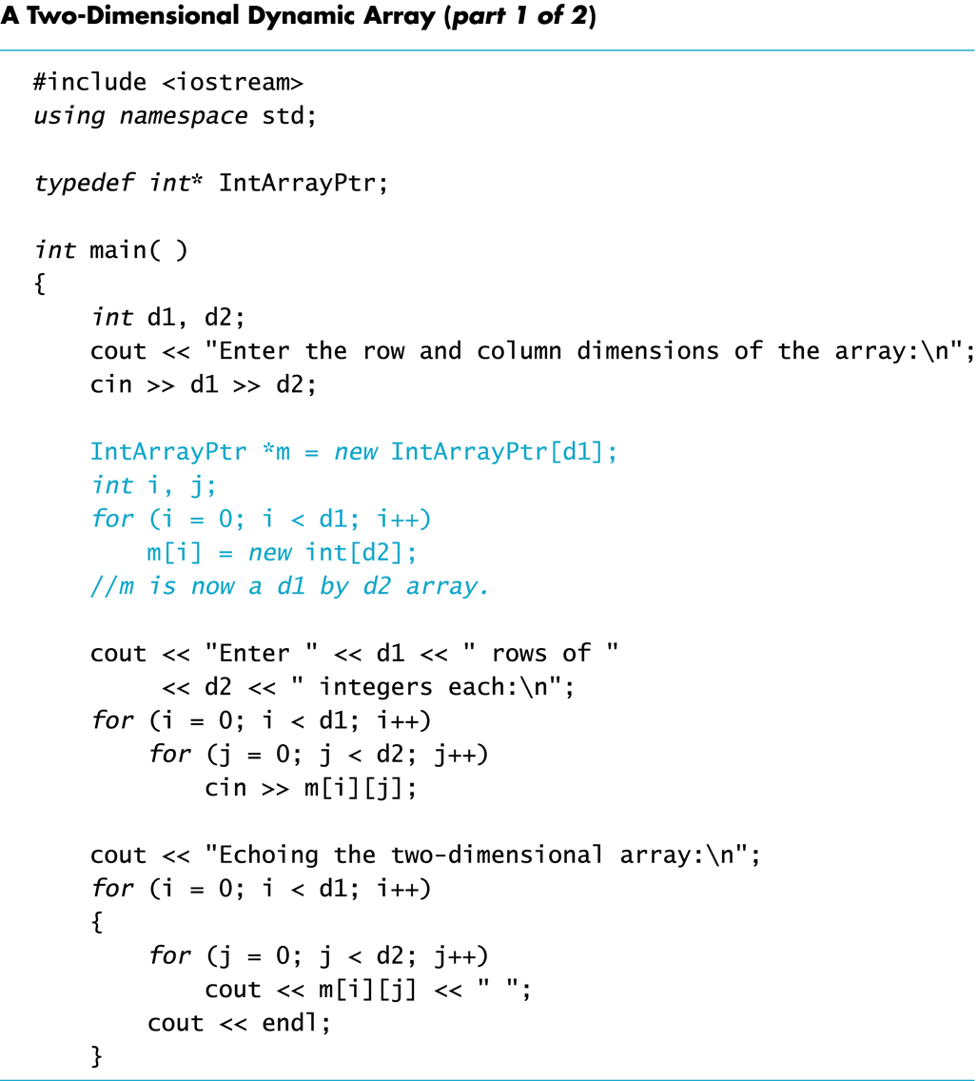

Slide 31
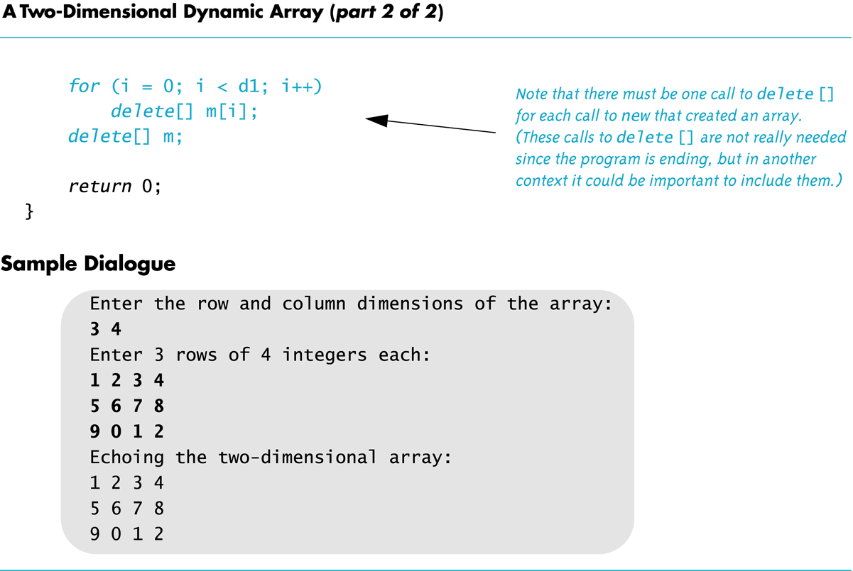

Slide 32
End
C++ was implemented commercially in 1985. What a great year! The plus plus? It’s the post-fix operator!

Slide 33
References
Slide contributions include:
Walter Savitch, Problem solving with C++ (9th Edition). Addison-Wesley Longman Publishing Co., Inc. Boston, MA, USA ©2015
Gaddis, Starting Out with C++: From Control Structures through Objects, (8th Ed.) , Addison-Wesley Longman Publishing Co., Inc. Boston, MA, USA ©2015
Bjarne Stroustrup, The C++ Programming Language, 3rd Edition, Addison-Wesley Longman Publishing Co., Inc. Boston, MA, USA ©2007
Herb Sutter, Andrei Alexandrescu, C++ coding standards : 101 rules, guidelines, and best practices, Copyright © 2005 Pearson Education, Inc.
Paul Deitel & Harvey Deitel, C++ How to Program, (7th Ed.) © 2010 by Pearson Education, Inc.
Upper Saddle River, New Jersey 07458
Scott Meyers, Effective Modern C++. Copyright © 2015 (O’Reilly) , 978-1-491-90399-5.
Andrew Koenig and Barbara E. Moo, Accelerated C++ Practical Programming by Example,
Addison-Wesley, 2000 ISBN 0-201-70353-X

Slide 34
References
Slide contributions include:
Frank M. Carrano. Data Abstraction & Problem Solving with C++ (5th Edition)
Addison-Wesley Longman Publishing Co., Inc. Boston, MA, USA ©2006
TutorialsPoint - http://www.tutorialspoint.com/cplusplus/
Cplusplus.com - http://www.cplusplus.com/doc/tutorial/

